Slide 1
Aspirational ULBs

Slide 2
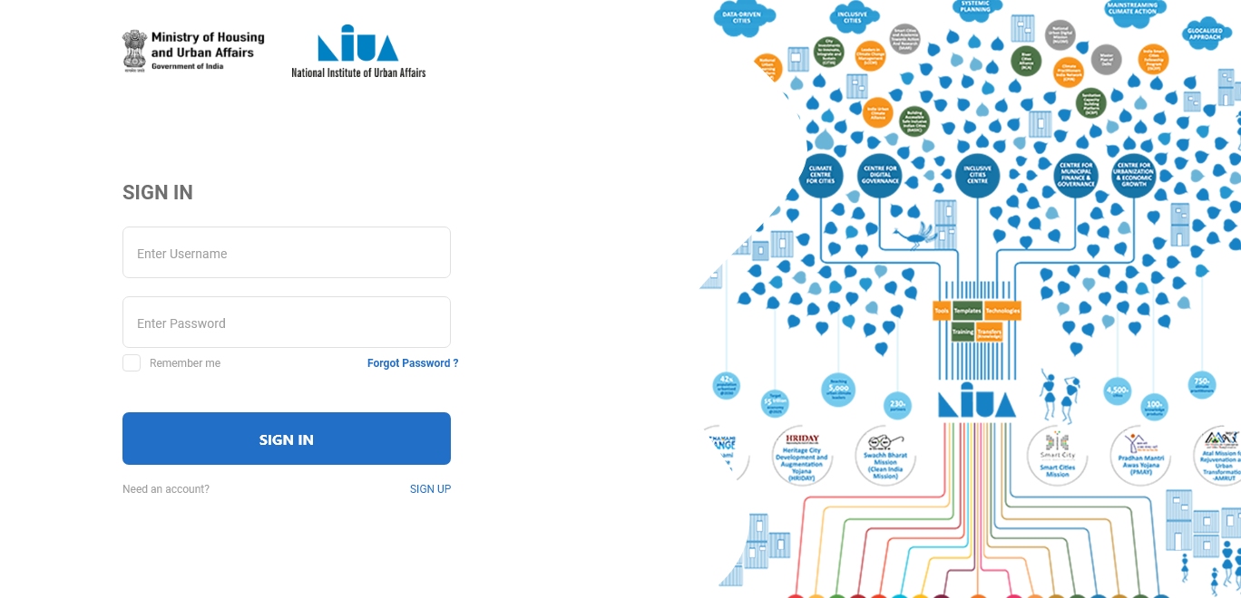
ULB Official

Slide 3

ULB Official

Slide 4
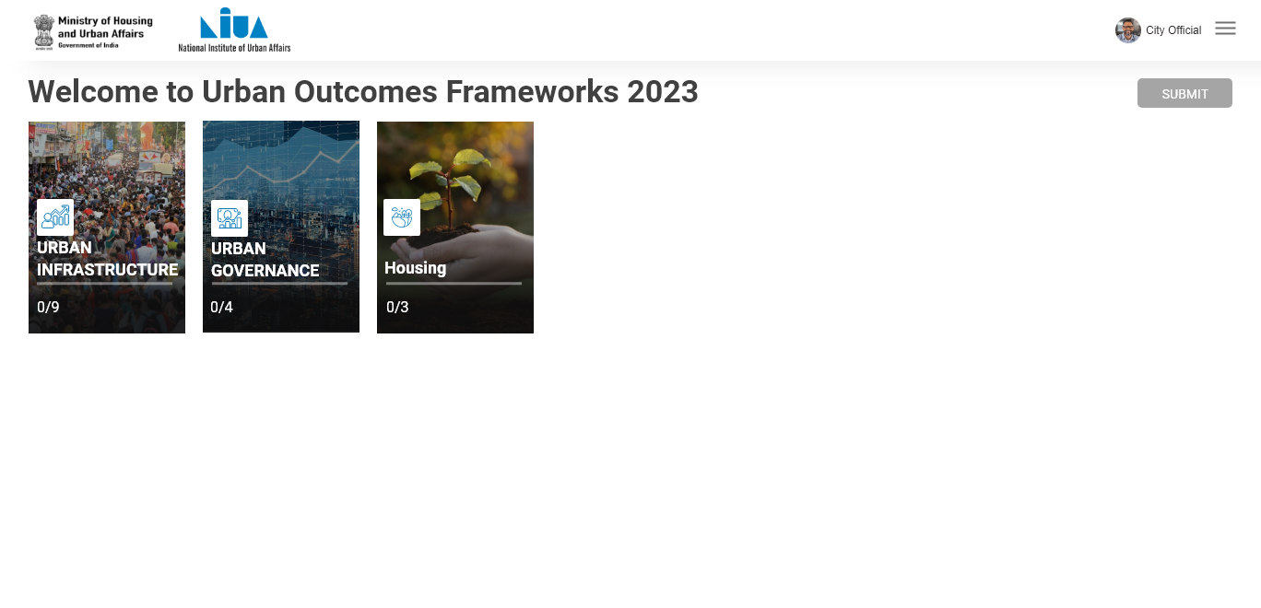
ULB Official

Slide 5
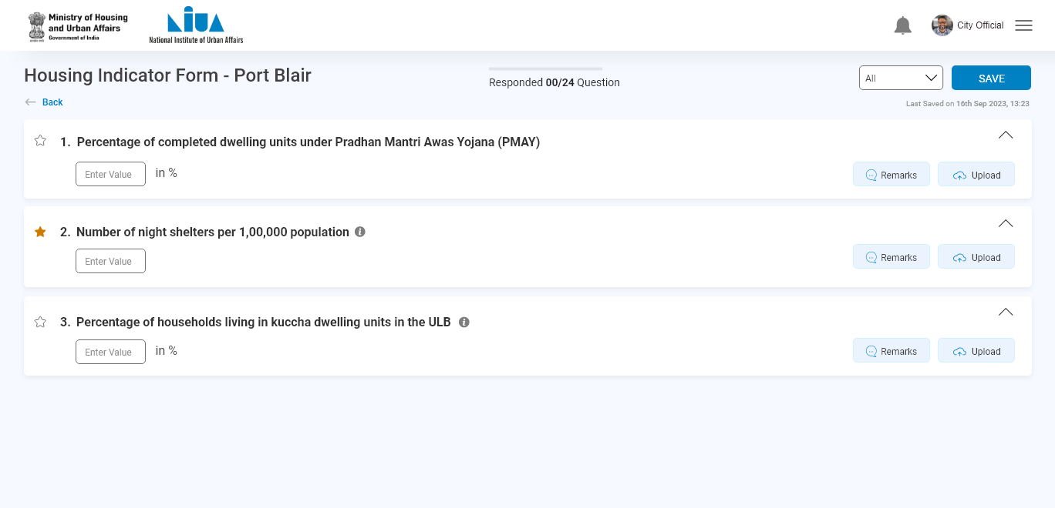
ULB Official
Click here !

Slide 6
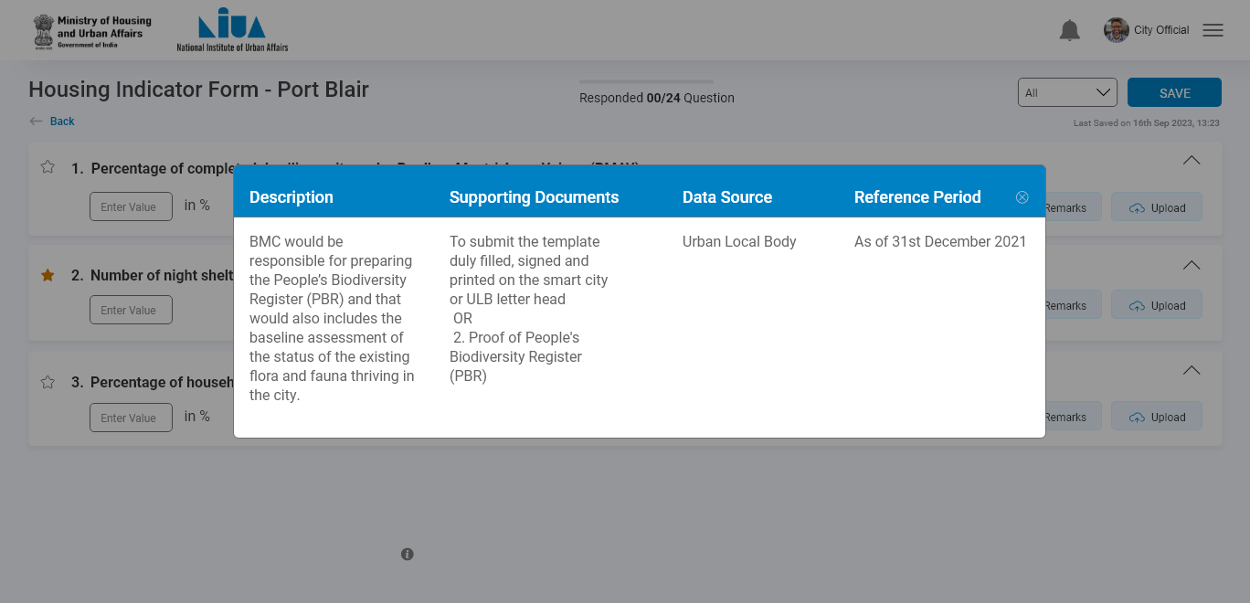
ULB Official

Slide 7
ULB Official
Click here !

Slide 8
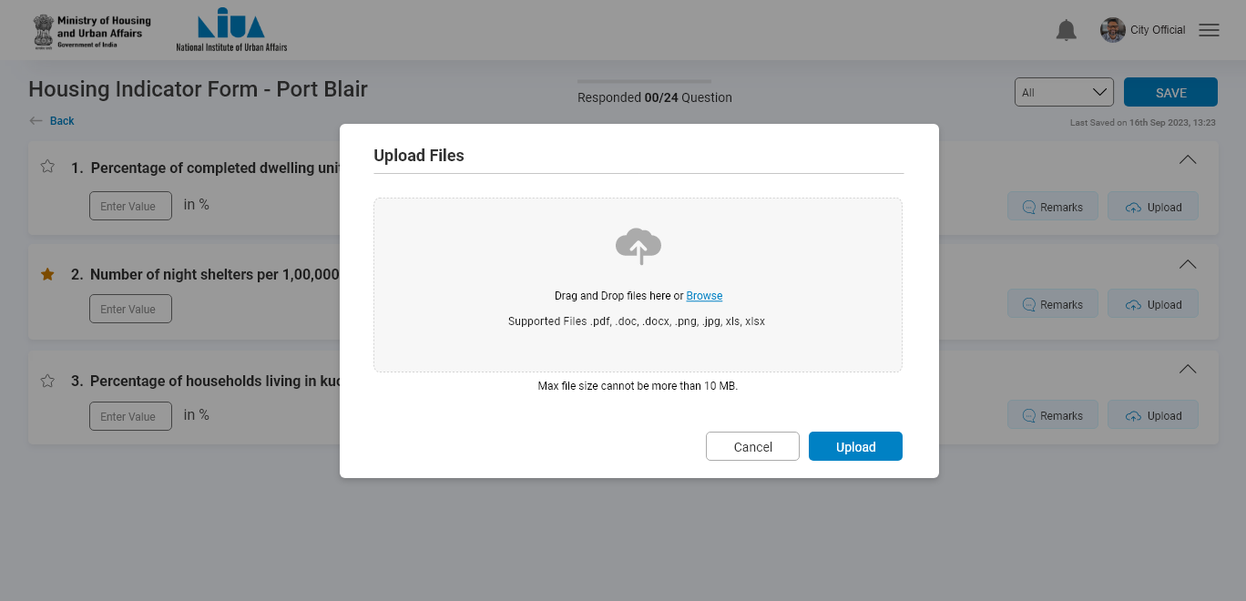
ULB Official

Slide 9

ULB Official
Click here !

Slide 10
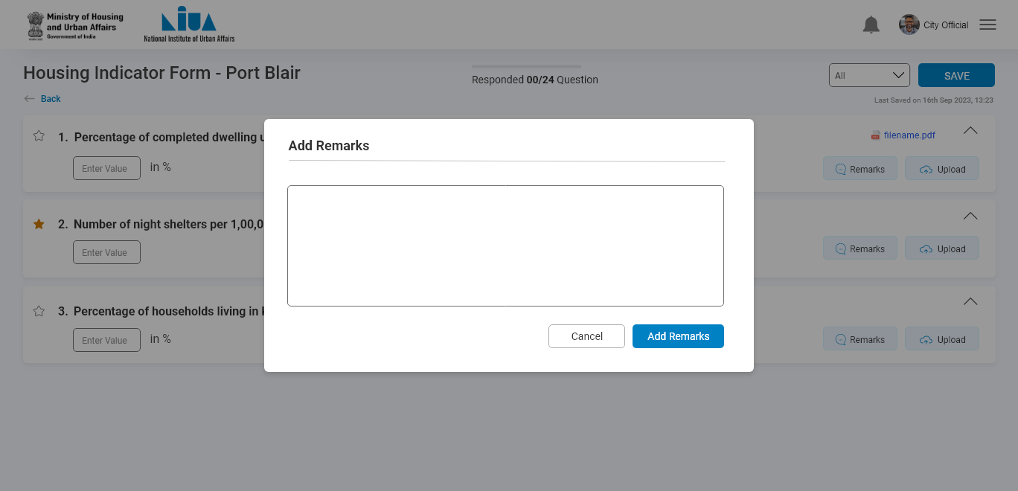
ULB Official

Slide 11
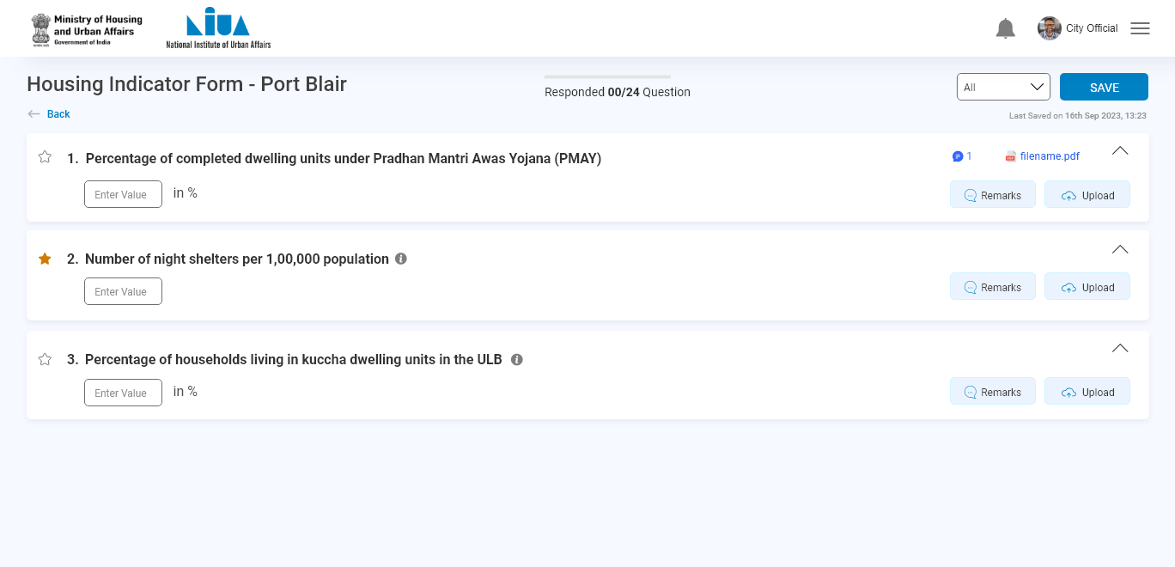
ULB Official

Slide 12
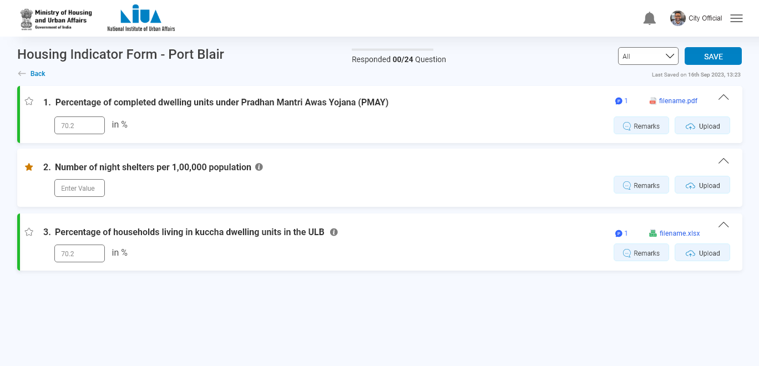
ULB Official
Similar actions can be done for this question

Slide 13
ULB Official
Click on save

Slide 14
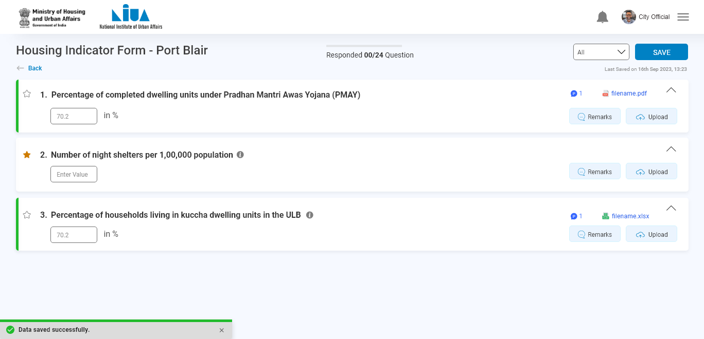
ULB Official

Slide 15
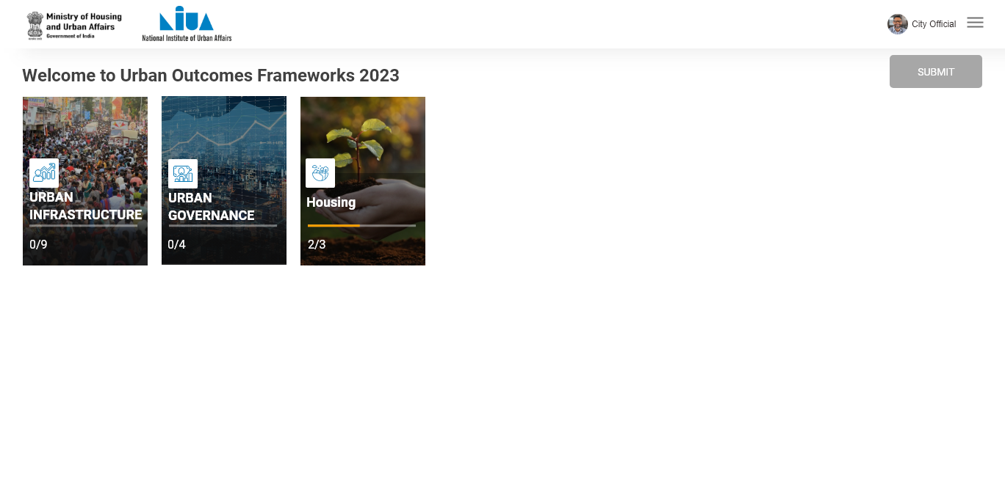
ULB Official
You can see the status here

Slide 16
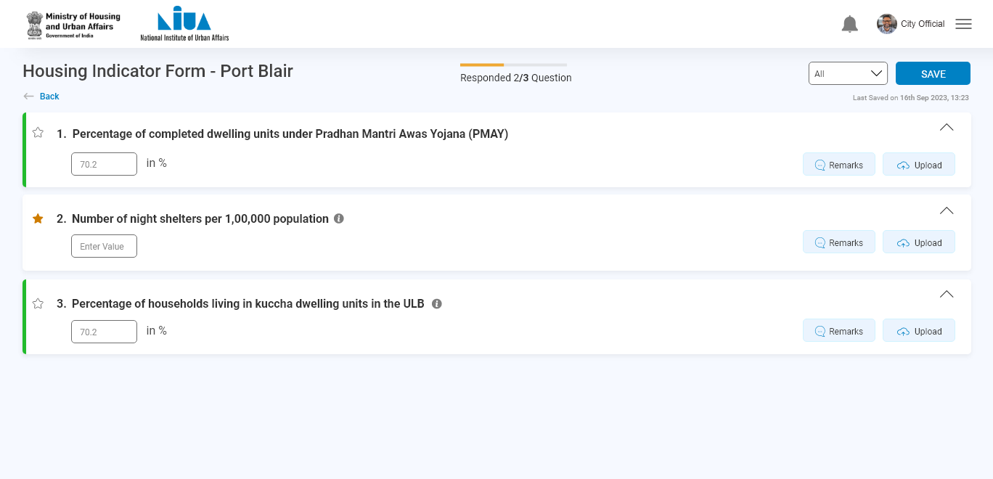
ULB Official
Select the category of bookmark question from here
Bookmark question

Slide 17
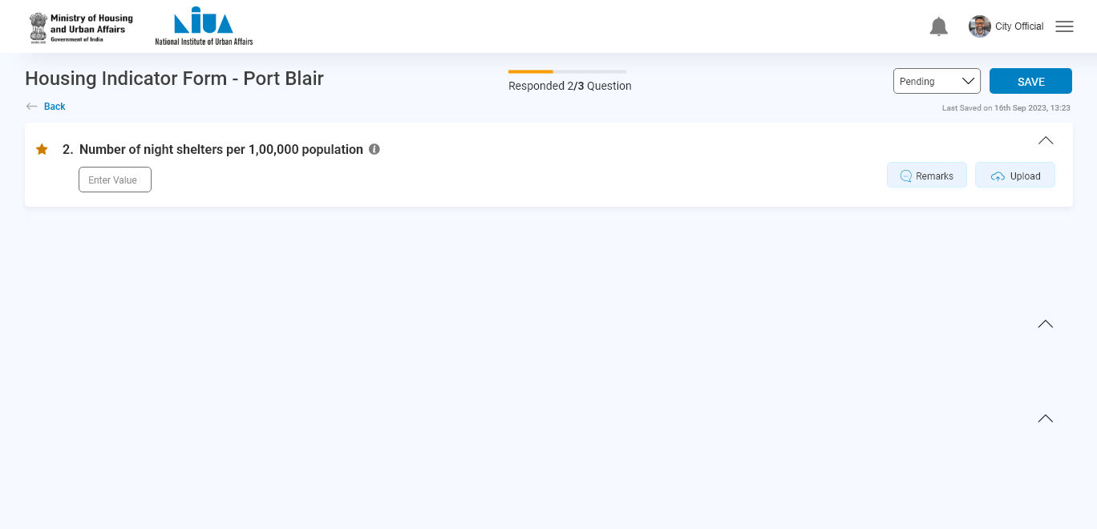
ULB Official

Slide 18
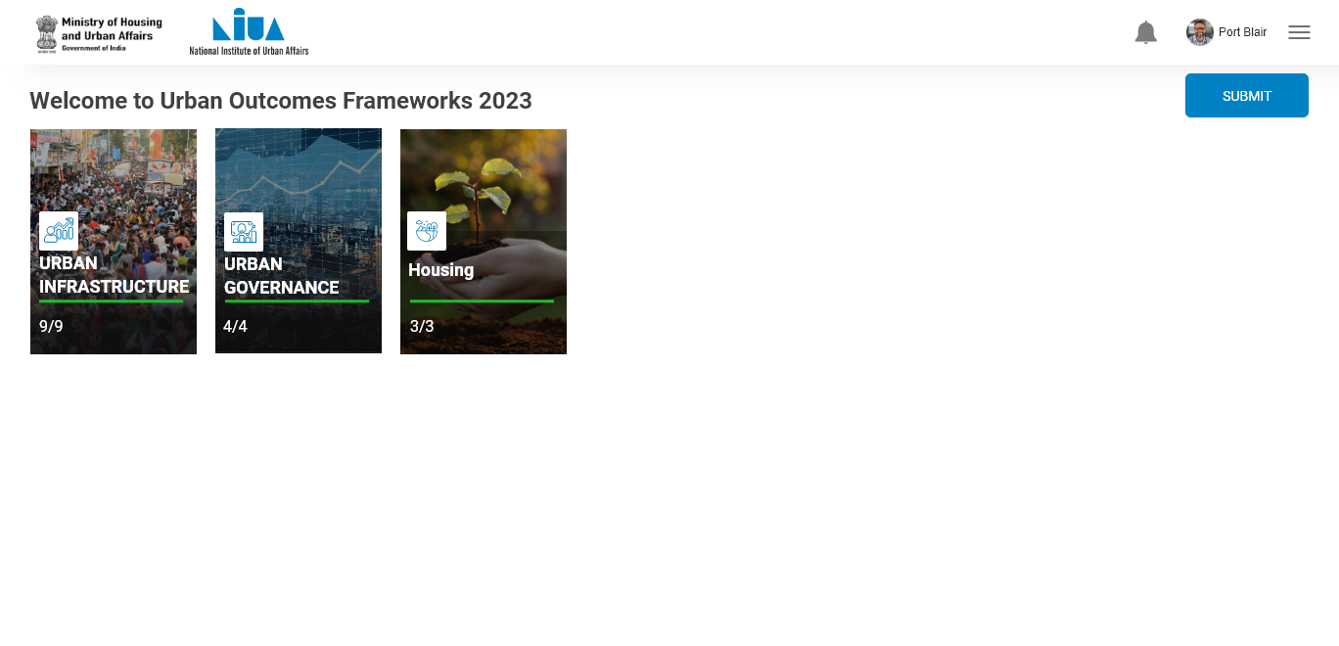
ULB Official
Click on submit
After submitting all the sectors , submit button activated

Slide 19
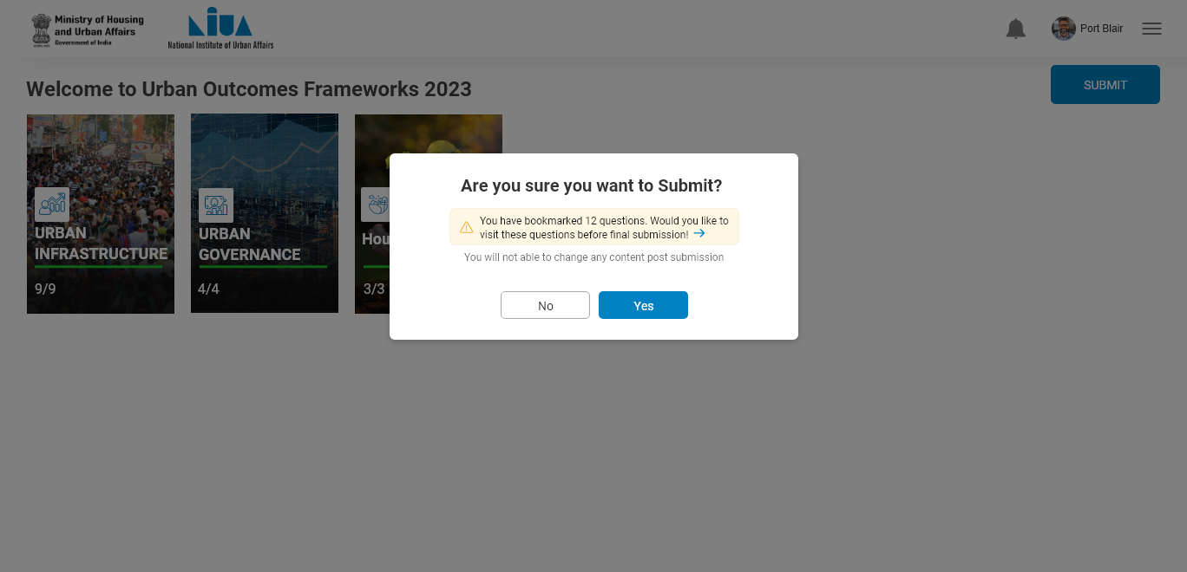
ULB Official

Slide 20
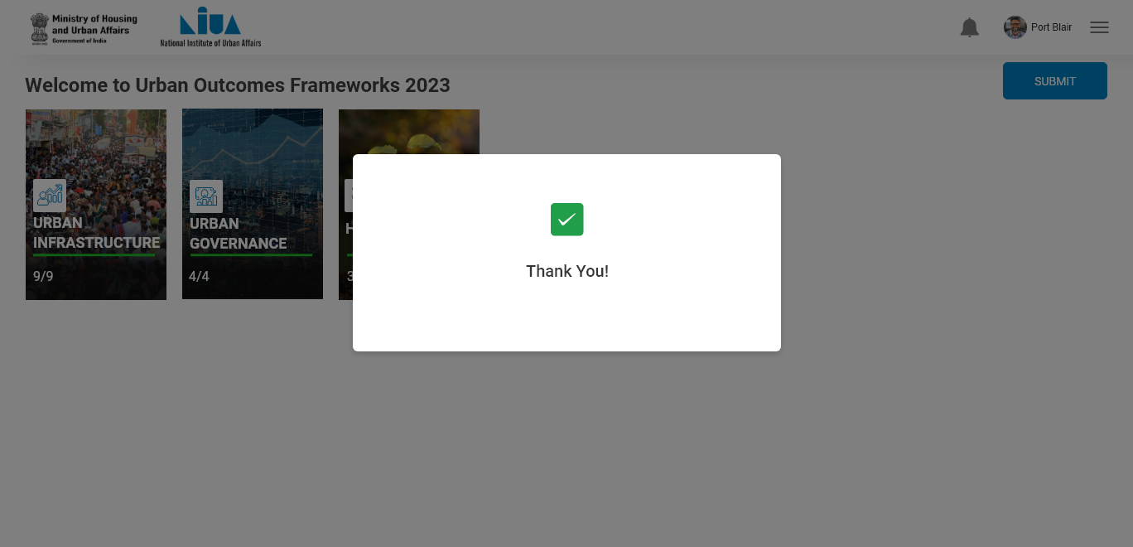
ULB Official

Slide 21

ULB Official
After submitting, through this button, nothing will be editable to city user

Slide 22
Validator 1

Slide 23

Validator 1

Slide 24
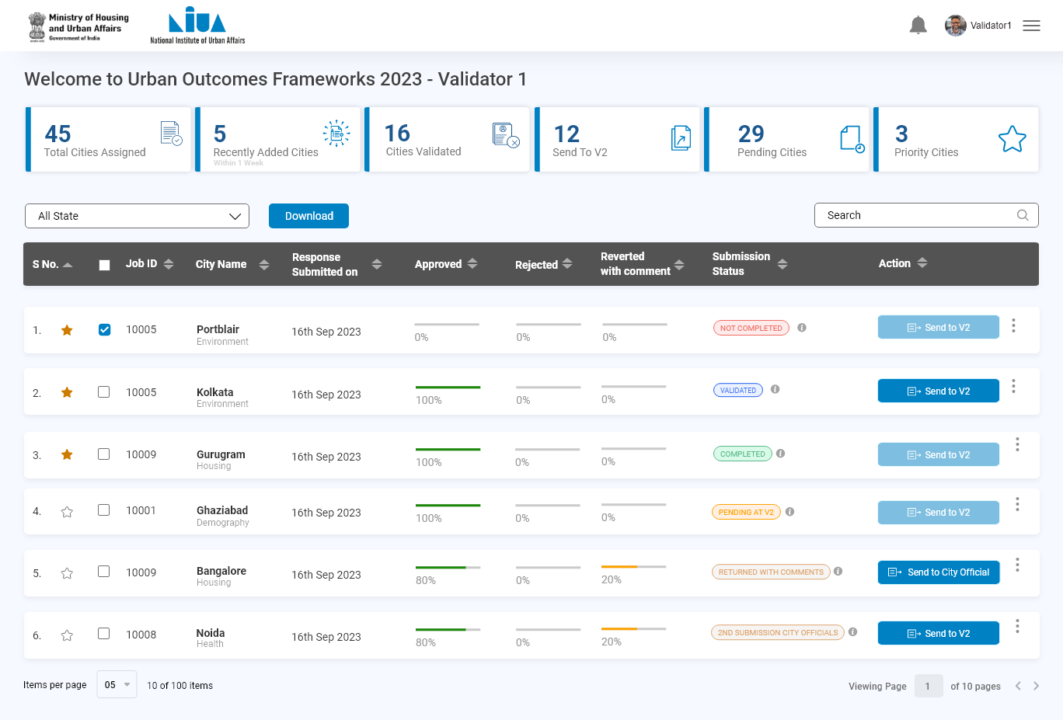
Validator 1

Slide 25
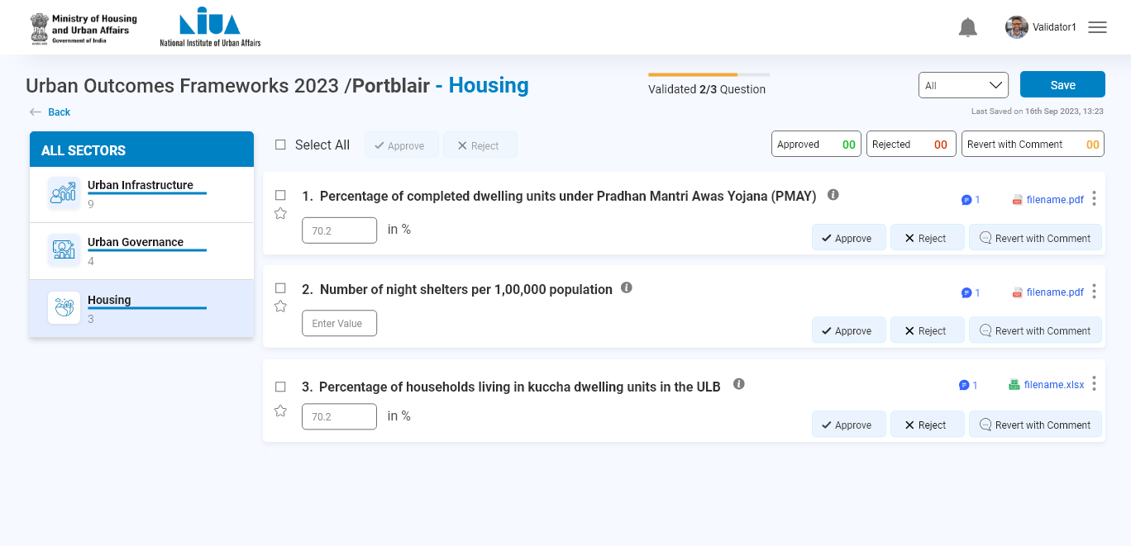
Validator 1

Slide 26
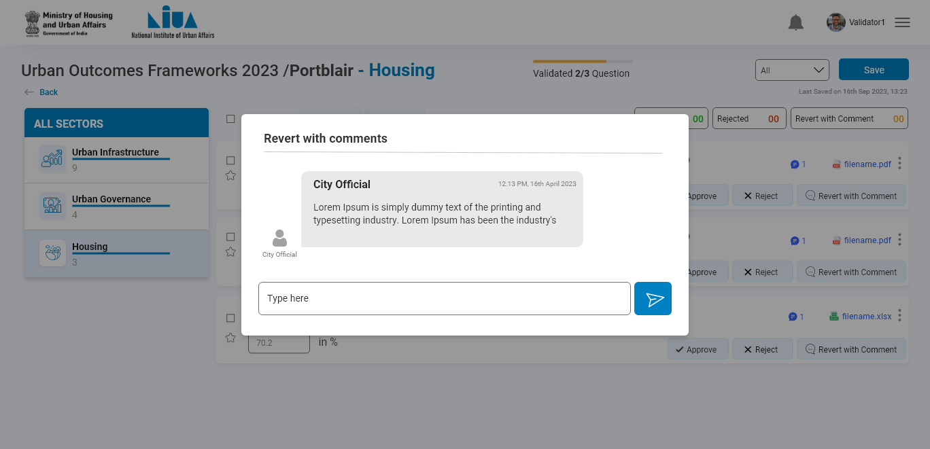
Validator 1

Slide 27

Validator 1

Slide 28
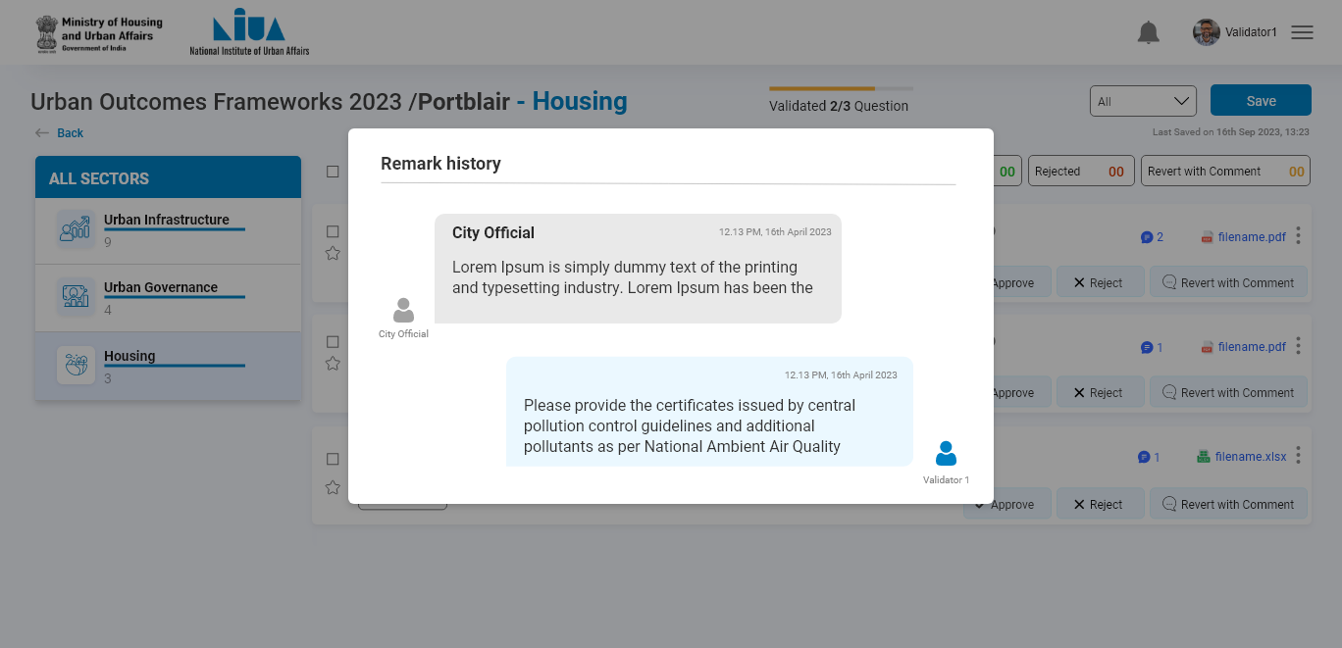
Validator 1

Slide 29
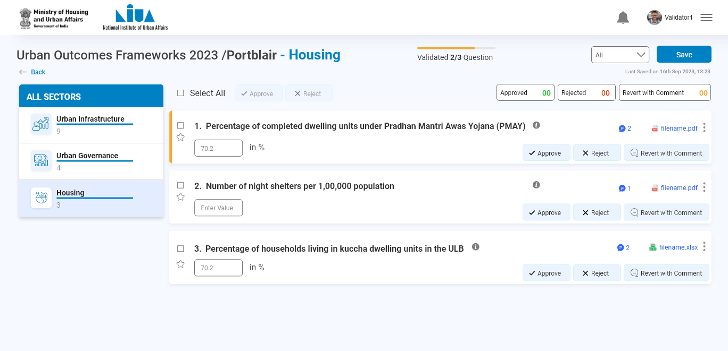
Validator 1

Slide 30
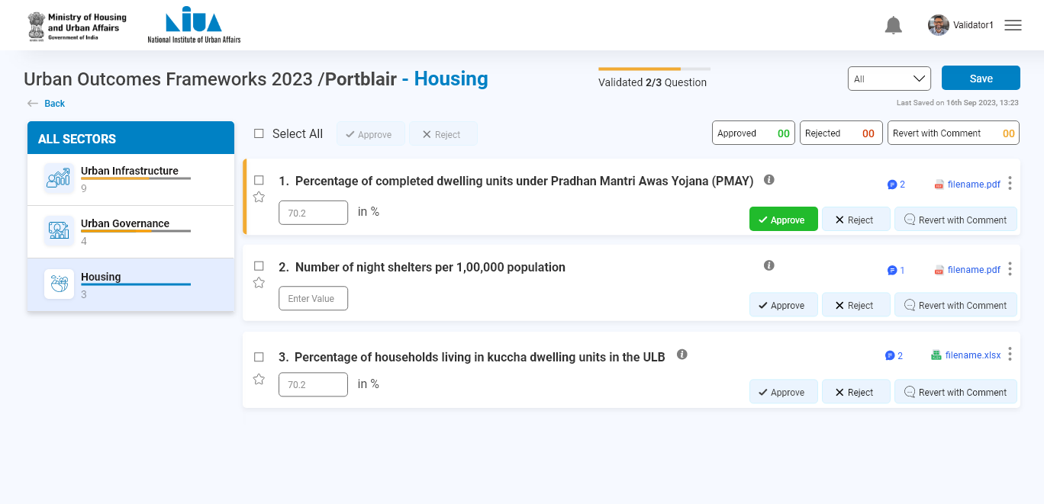
Validator 1

Slide 31
Validator 2

Slide 32

Validator 2

Slide 33
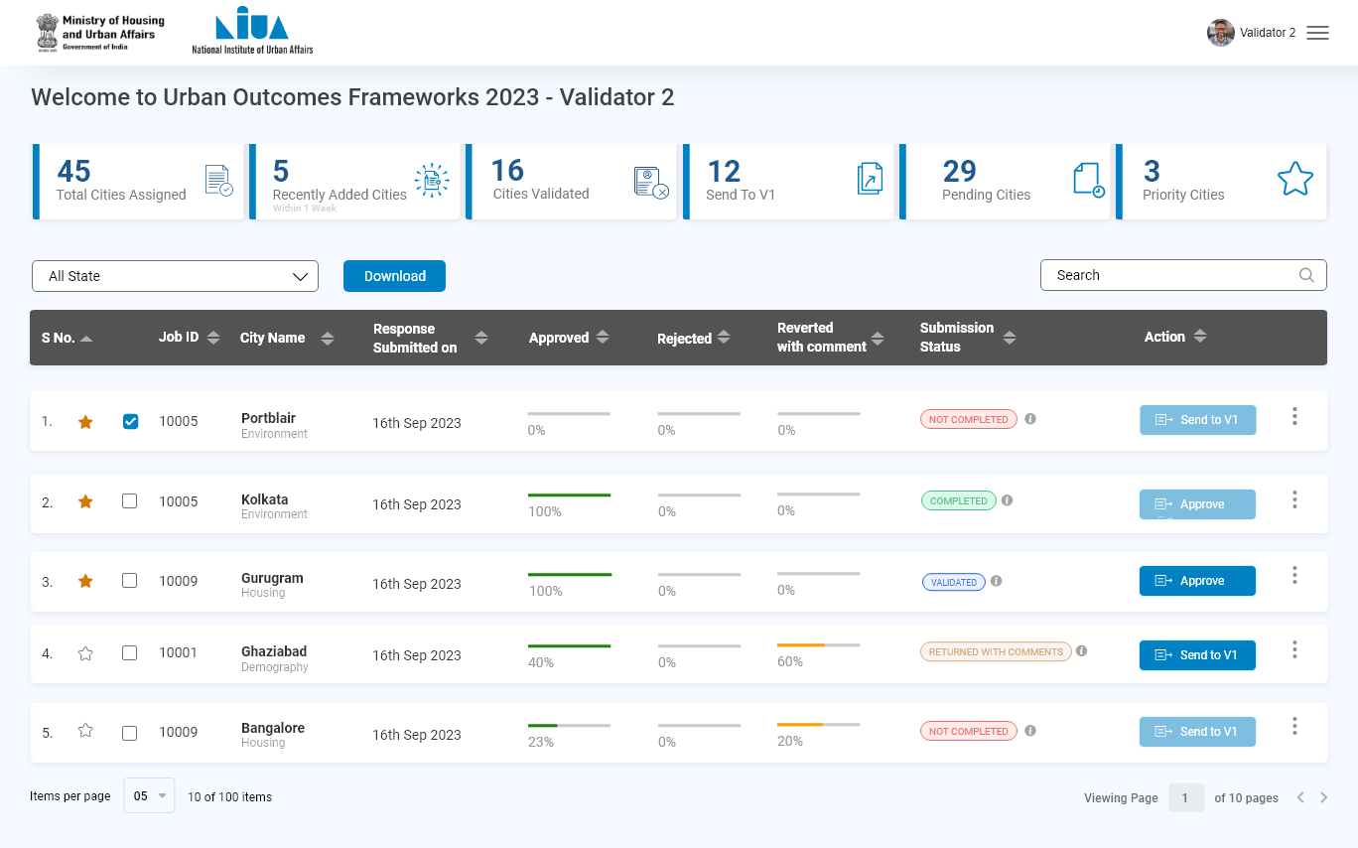
Validator 2

Slide 34
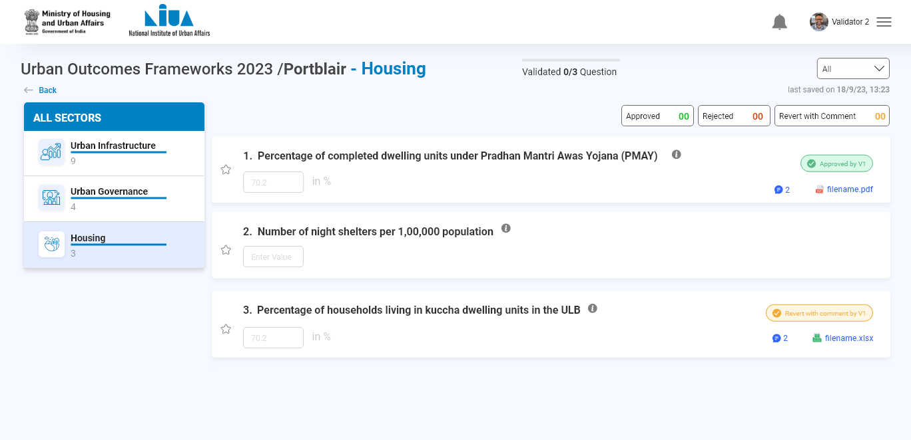
Validator 2

Slide 35
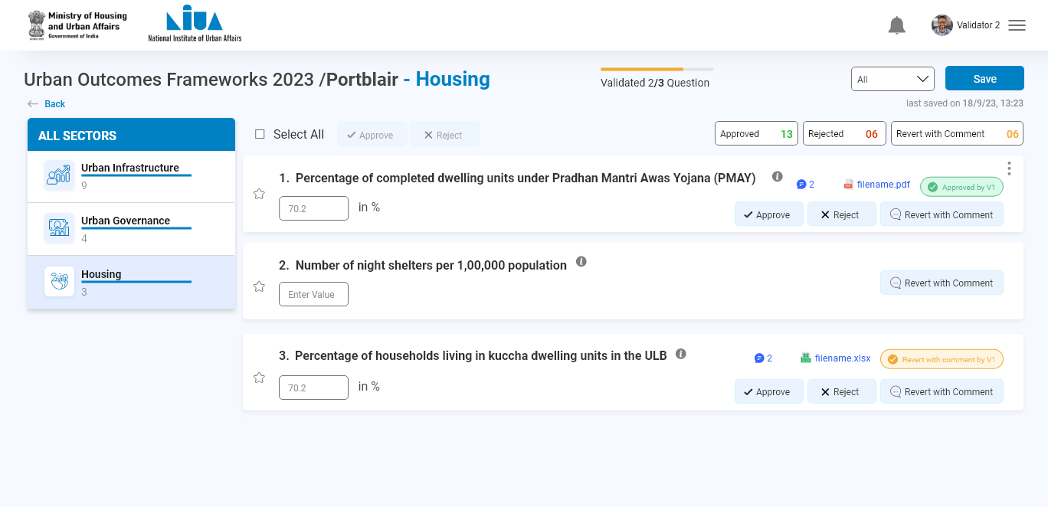
Validator 2

Slide 36
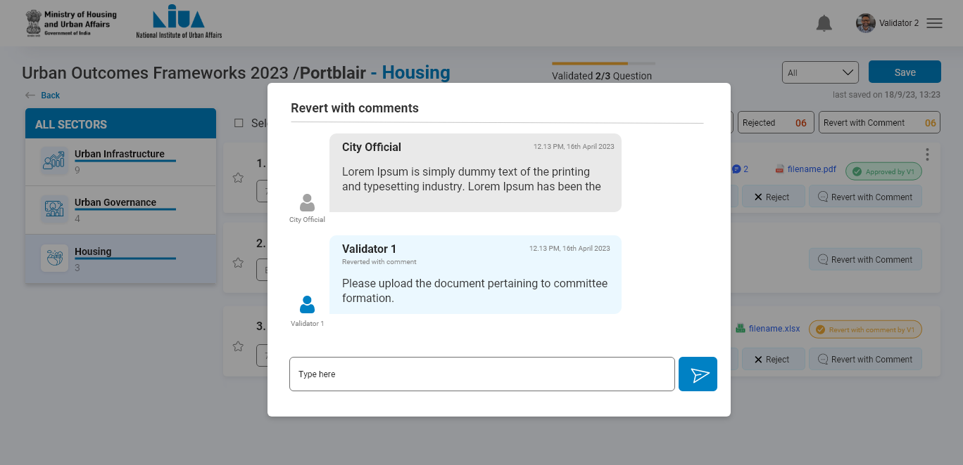
Validator 2

Slide 37

Validator 2

Slide 38
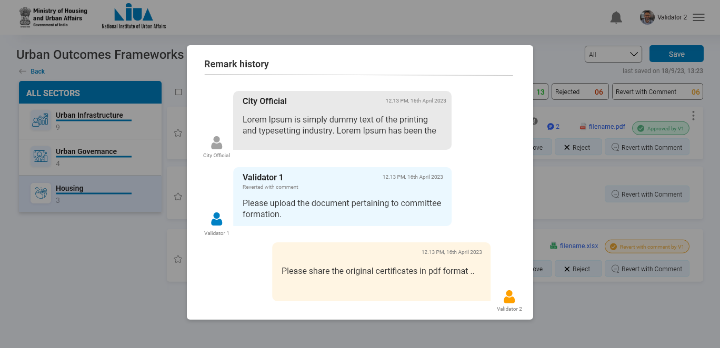
Validator 2

Slide 39

Validator 2

Slide 40
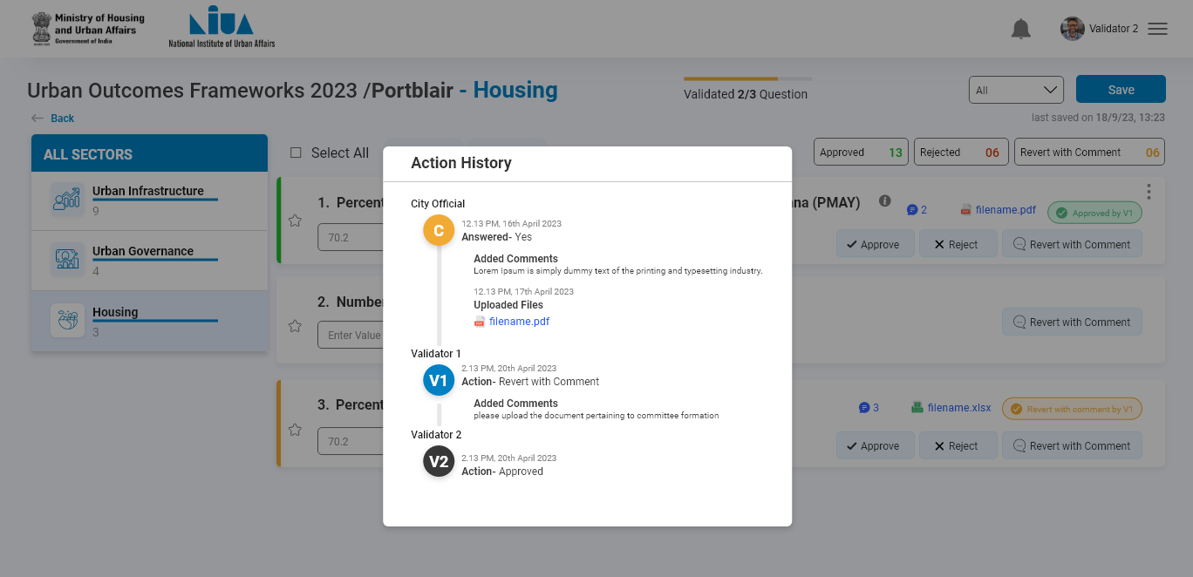
Validator 2

Slide 41
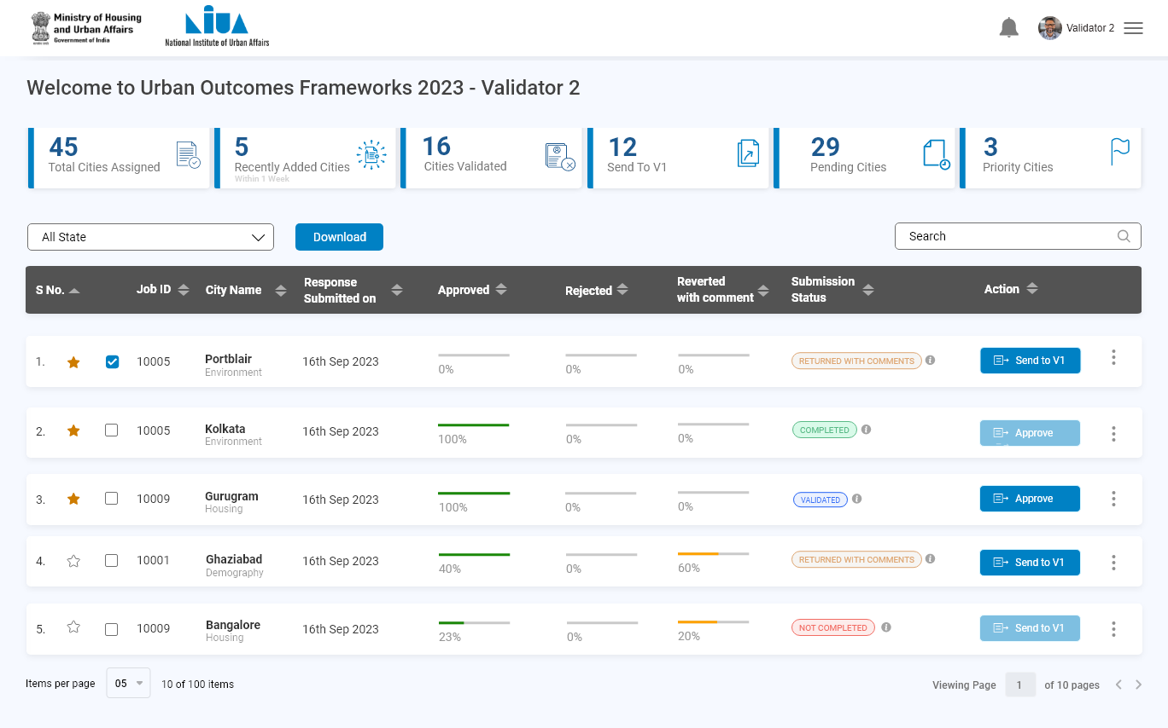
Validator 2

Slide 42
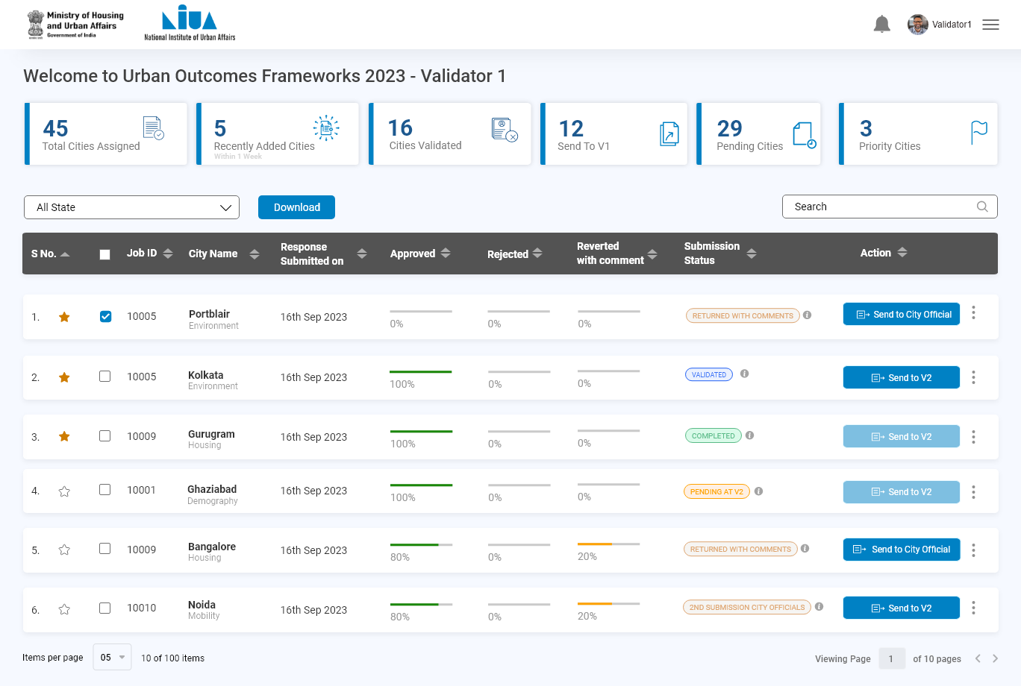
Validator 2

Slide 43
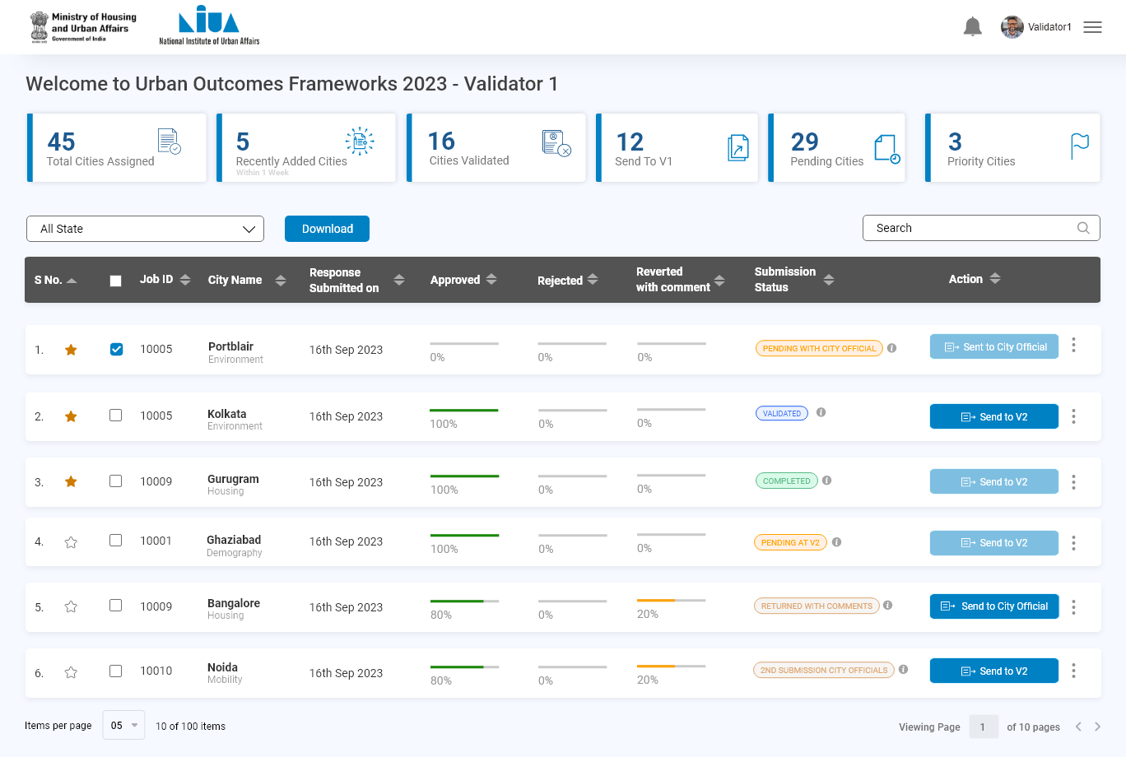
Validator 2

Slide 44
ULB Official
Relogin to view the comments

Slide 45

ULB Official

Slide 46
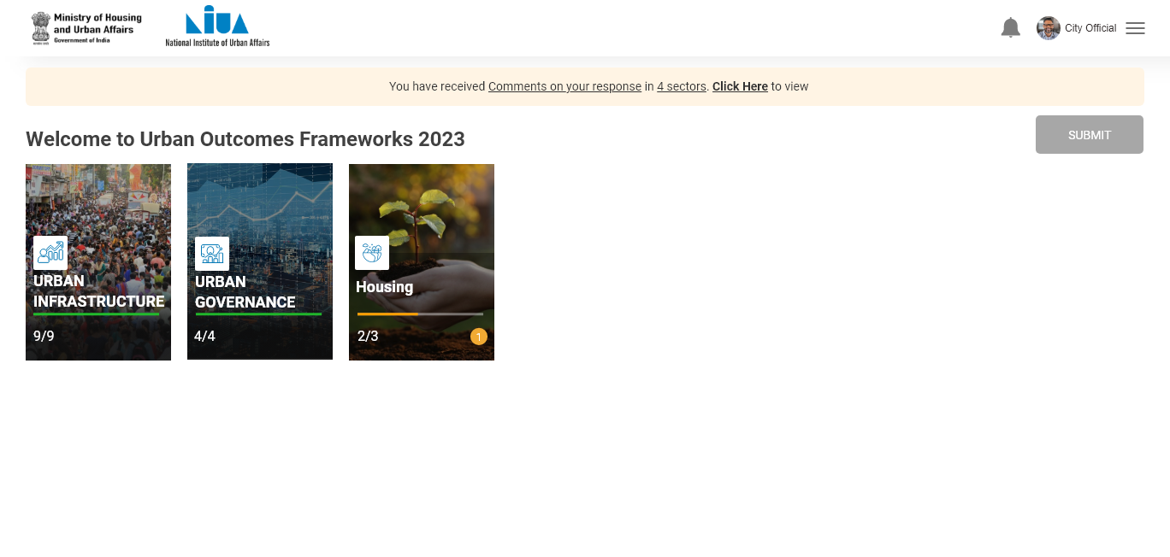
ULB Official

Slide 47
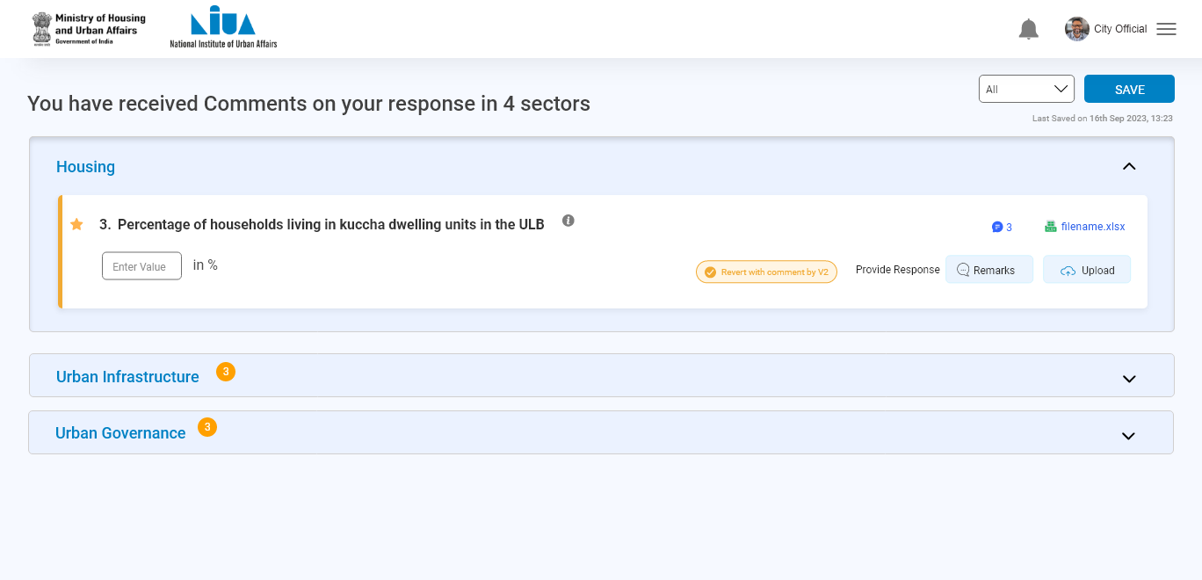
ULB Official

Slide 48
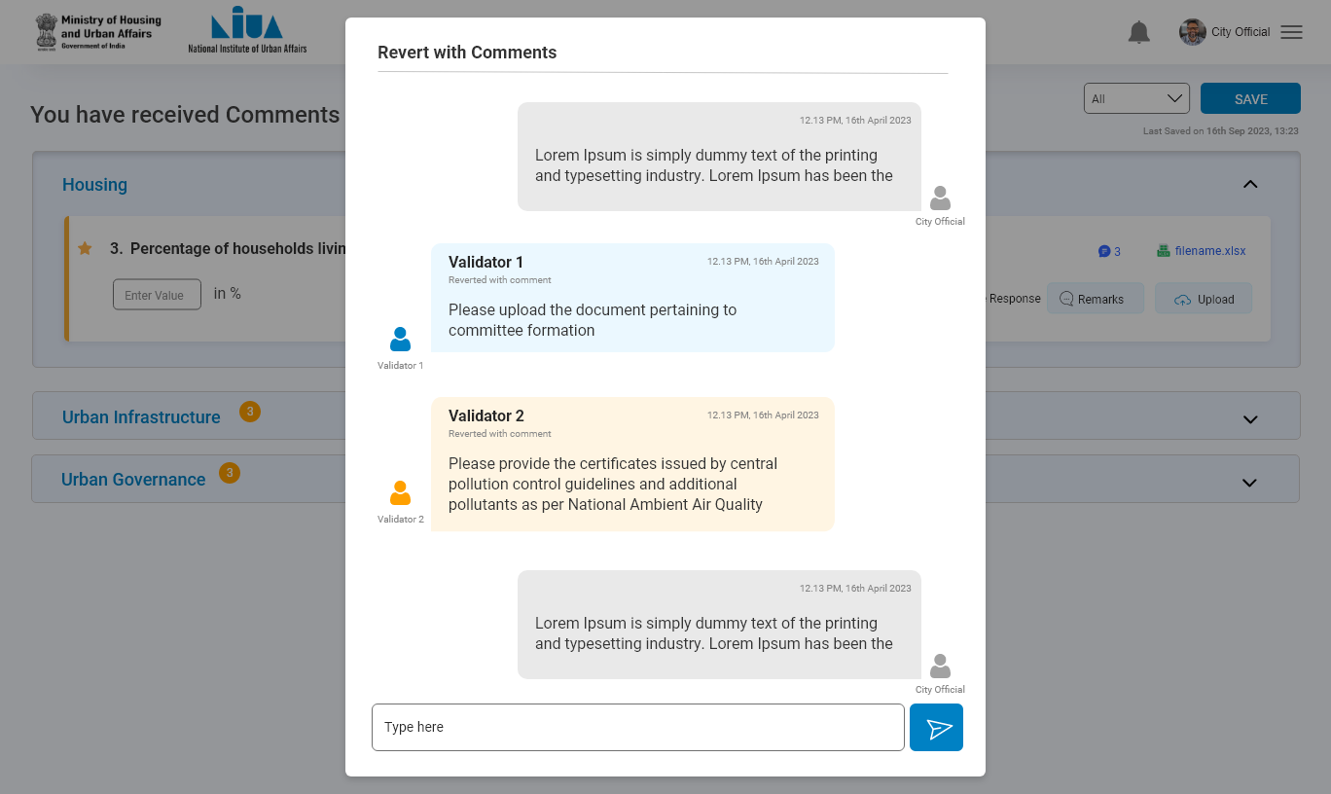
ULB Official

Slide 49

ULB Official

Slide 50
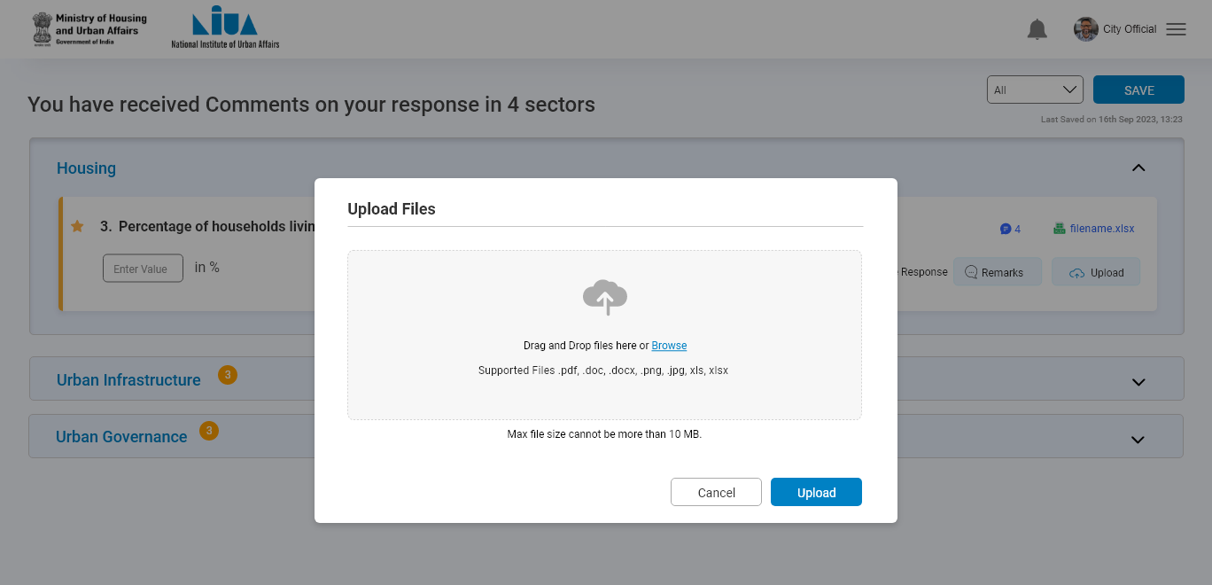
ULB Official

Slide 51
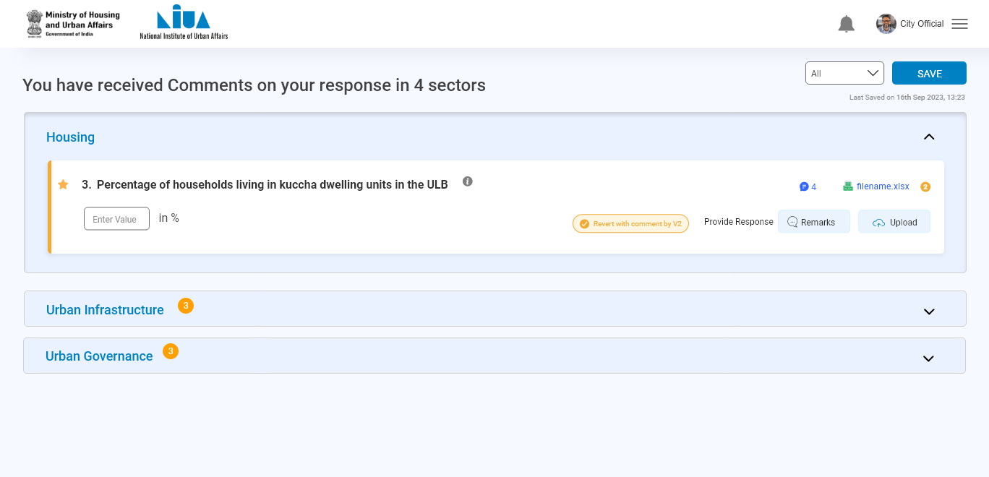
ULB Official

Slide 52
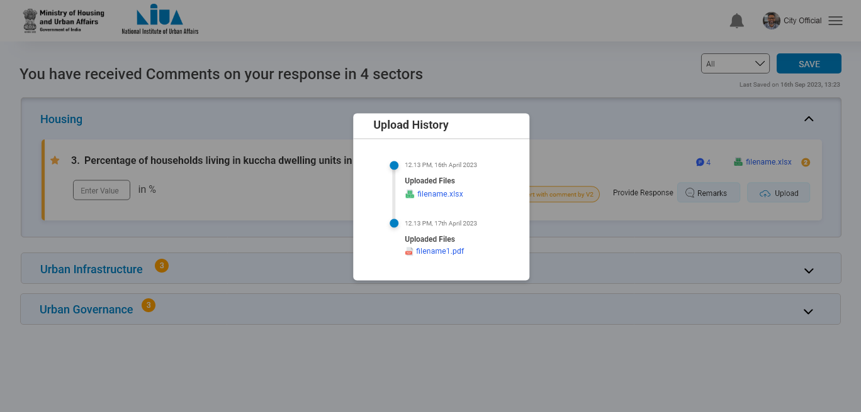
ULB Official

Slide 53
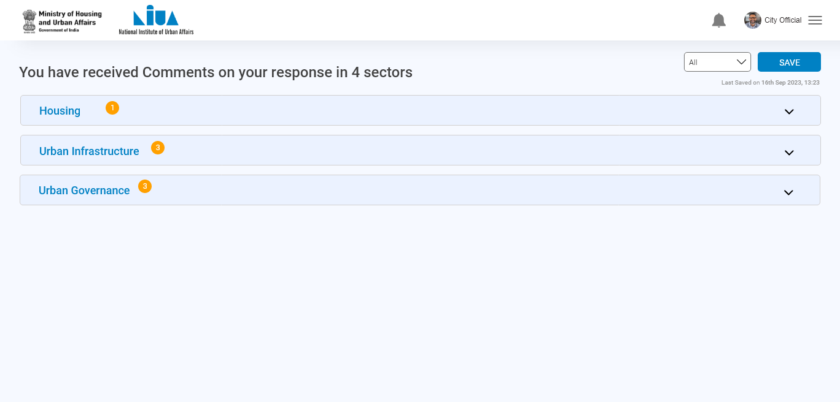
ULB Official

Slide 54
ULB Official
Click on submit
After re-submitting all the reverted question , submit button activated

Slide 55
ULB Official

Slide 56
ULB Official

